Slide 1
1.4 Assignment
Benjamin Melitz, Daniel Jang, Jimin Hong, Tanush Deka

Slide 2
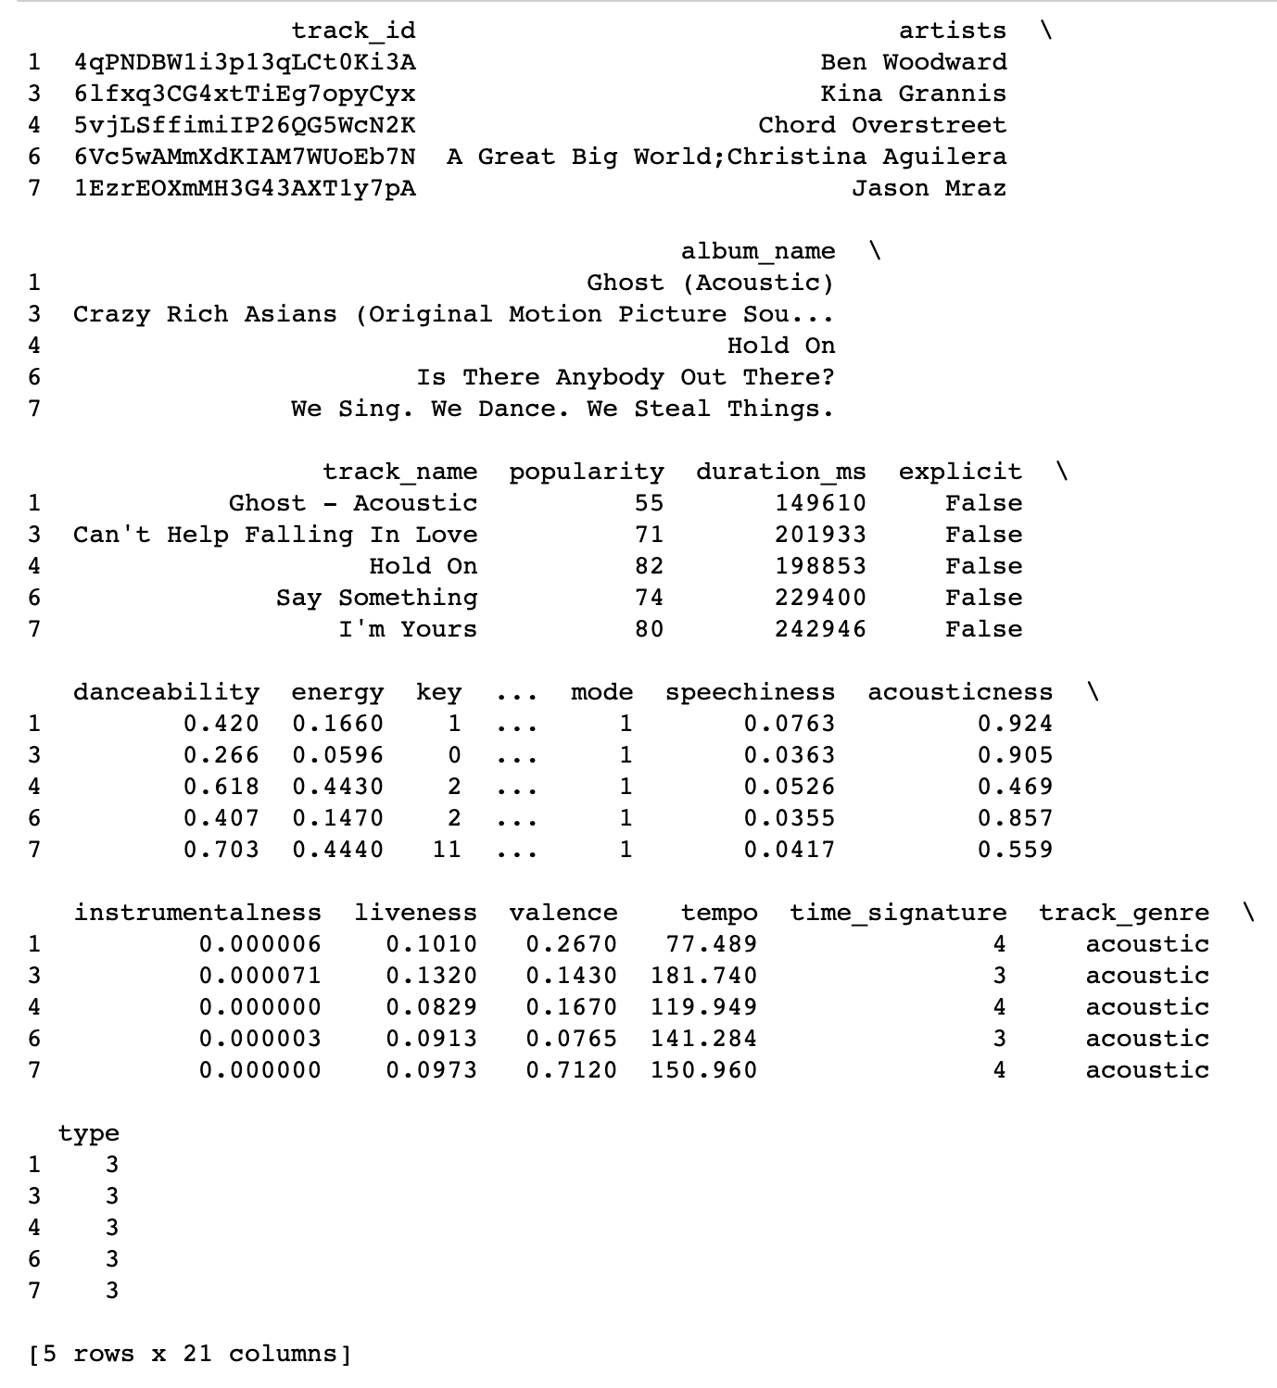
Original Model
The original model used the kmeans library to make 5 clusters of spotify songs. The user inputs their favorite songs by id, and then the model finds songs in the same group to suggest to the user.
Output of the model after song ids are input:
Pros: Used unsupervised learning to make clusters
Cons: Only 5 clusters, Unformatted Output

Slide 3
Model Enhancements: Outlier Removal
The first enhancement was removing outliers from the dataset. This allowed for better representation of the data, and more practical clusters of songs. Using the scipy library, we calculated the z scores of the ‘tracks’ dataframe using the scipy.stats.zscore function. Outliers were any entries where at least one column had a z score of more than 4 or less than -4 (~1.26% of entries). Without outliers, the model does not have to make small groups for a couple outlier songs and can be focus on the majority of songs

Slide 4
Model Enhancements: Other Models
The next enhancement was using other models, like DBSCAN and agglomerative clustering. The agglomerative clustering model took too long on the large dataset, so we used the Birch algorithm in sklearn.cluster instead.

Slide 5
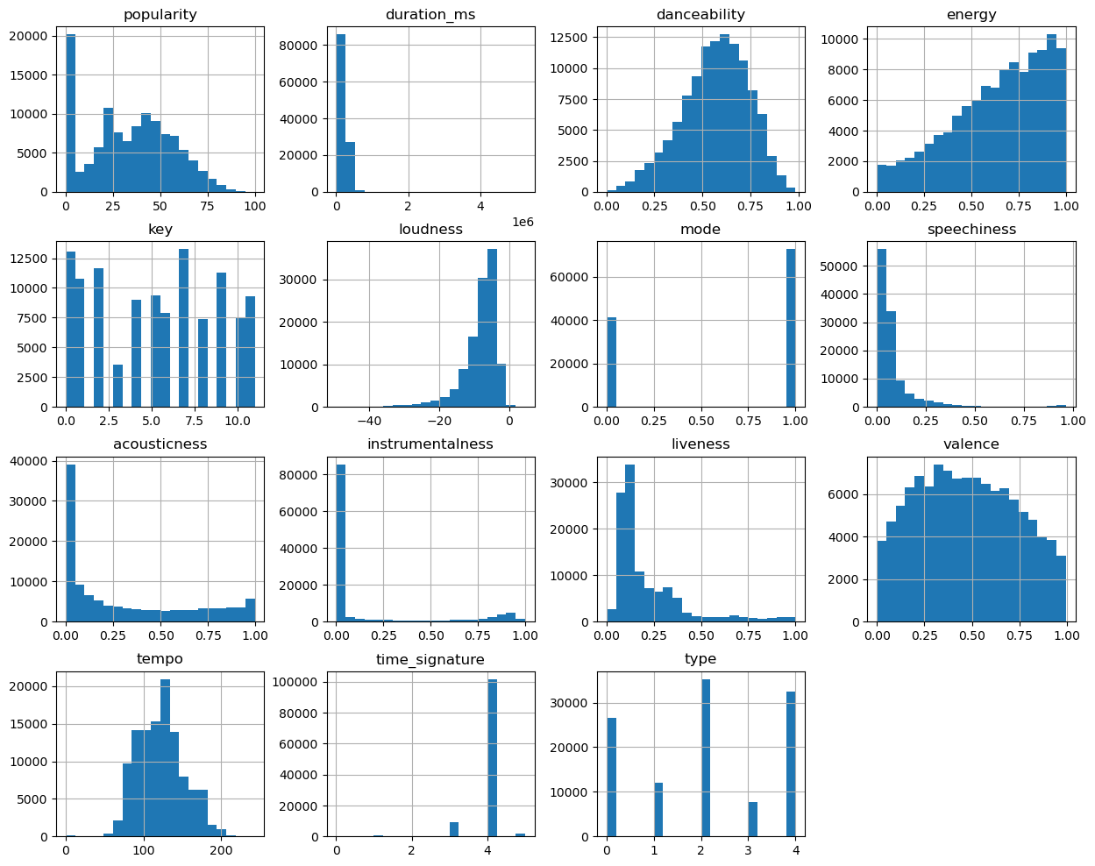
Feature Distributions
Plots of the columns from the spotify dataset

Slide 6
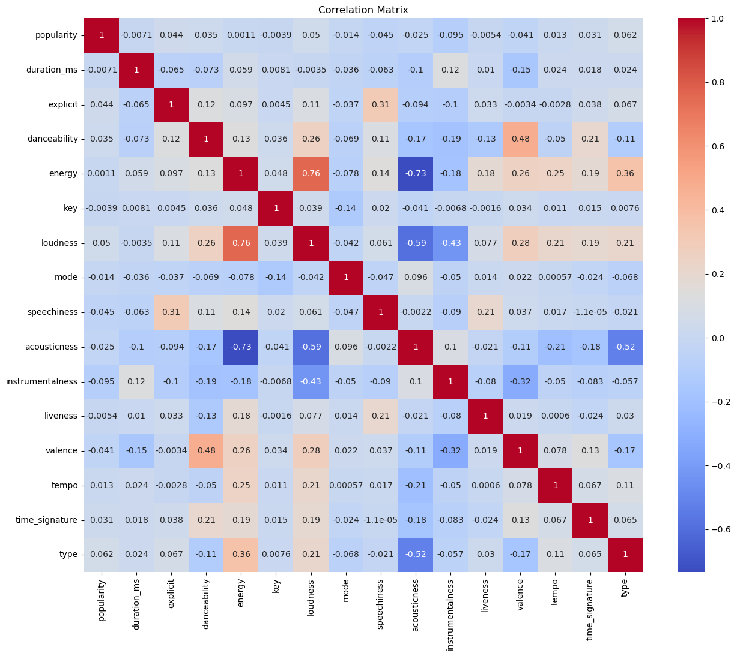
Correlation Matrix
Correlation matrix of the columns from the spotify dataset

Slide 7
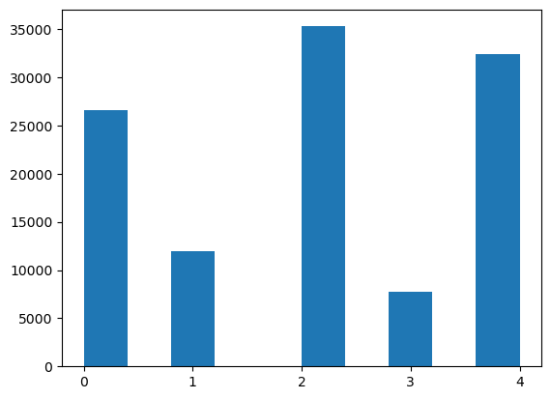
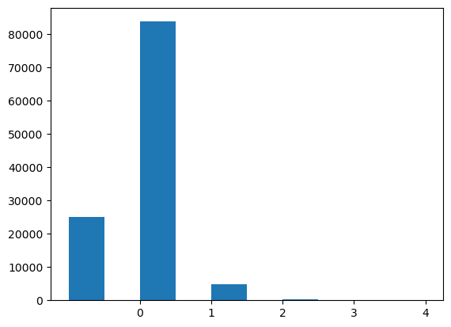
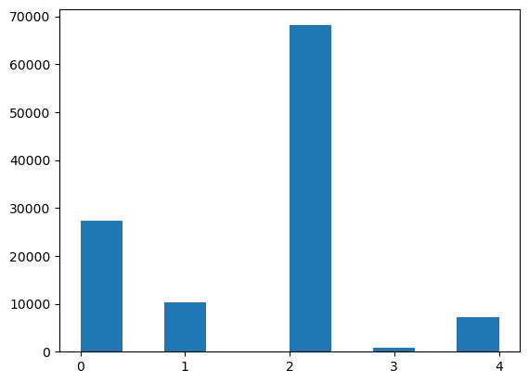
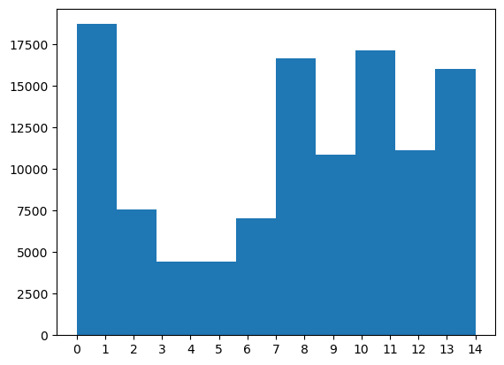
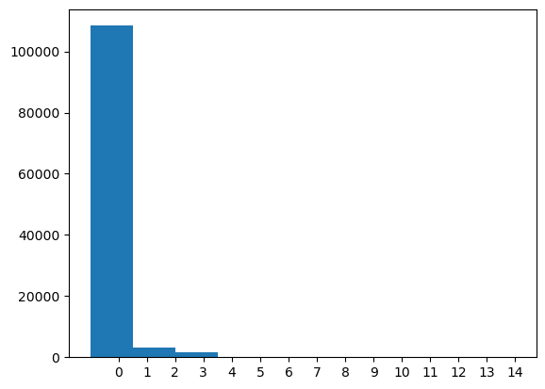
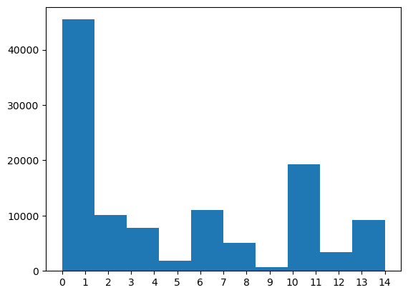
Model Cluster Comparison
KMeans
DBSCAN
Birch
5 Clusters
15 Clusters

Slide 8
Number of Cluster Comparisons
We tried the silhouette method, but it took too long. Here are results from the elbow test with kmeans. The elbow test takes the number of clusters where the distortion point levels off. Distortion point measures distance from data points to center of cluster. We chose 15 clusters
5 clusters with value of 423432.3, 10 clusters with value of 267103.8
15 clusters with value of 221535.1, 20 clusters with value of 195752.4
25 clusters with value of 177833.0, 30 clusters with value of 165197.3
35 clusters with value of 154795.6, 40 clusters with value of 146217.4

Slide 9
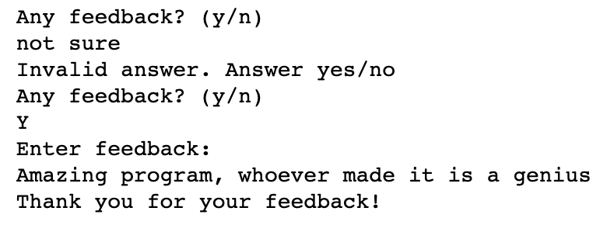
User Feedback
To collect feedback, first we ask the user if they want to submit feedback. If the user enters one of the following answers: y, yes, n, no (in any case) then it accepts the answer, otherwise it asks again. If the user enters y or yes, the program asks for feedback and adds the feedback to a ‘feedback.txt’ file. If no ‘feedback.txt’ file exists, one is created. Example interaction:
The impact of collecting feedback means that the users of the program have a voice on how to fix/update the program, and we can make changes to the program to meet the needs of the users. It provides interaction between the user and the programmer/s

Slide 10
Future Enhancements
The program could take a playlist link and recommend songs from the link
The program could give a nice interface or GUI for the user
The program could choose genres of music to include/exclude in the recommendations
The program could ask the user if the recommendations were good or not, and learn from the feedback to include or exclude songs like the ones it recommended

